Slide 1


Flashing process
Realized by: Hayfa Selmi
Reviewed by: Salah Harhira
2023/2024

Slide 2
Summary
I/ Preconditions
II/ PDX charging
III/ FA charging
IV/ TAL generating
V/ ModelStarter
VI/TCF upload and creation
VII/ Start Application, control desk

Slide 3


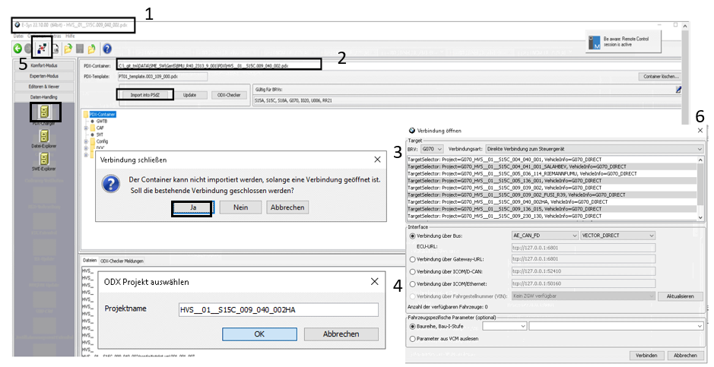
II/ PDX charging:
1) Go to Esys 22.10.00
2) Set the PDX container of the specific SW version and import it into PSDZ
3) “Verbindung schlieben” pop-up appears , click on “Ja”
4) Set the project name
5) Establish the connection
6) Choose the project name that you set in step 4

Slide 4
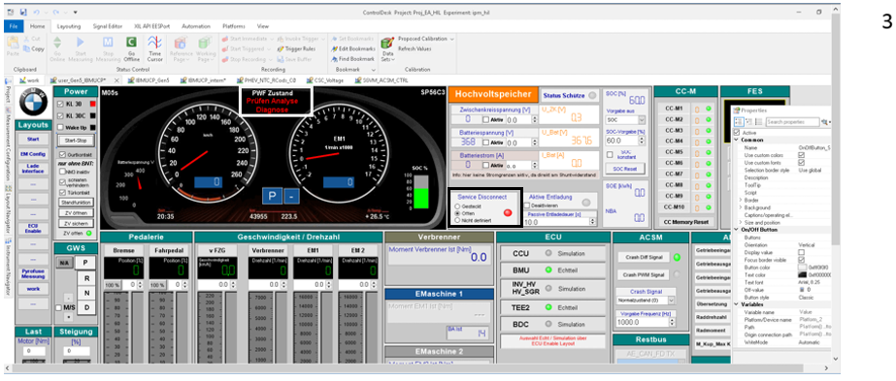
I/ Preconditions:
Connect to Hil and check if it‘s in normal status ( contactros closed + 4 DTC in PHEV +5 DTC in BEV)
Stop the TCF file in ECU
Set the PAD diag mode in control desk and open the contactors

Slide 5
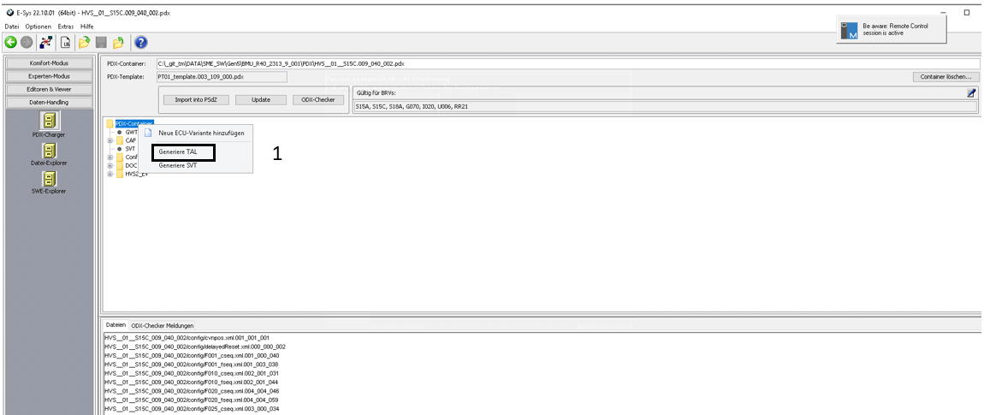
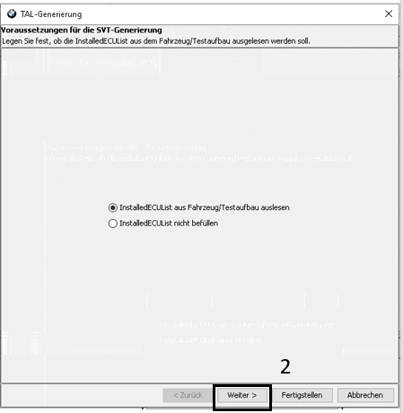
IV/ TAL generating:
Generate TAL from Pdx container
Click on Next
Choose the diagnose adresse “ 07“
Choose the appropiate SWFL option which you can find it located in the software folder C:\_git_tm\DATA\SME_SW\Gen5_PHEV\BMU_PHEV_R39_2251_9_010_C\PstInfos
Add the CAF
If an error message appears, then press ok
Ignore the alert If CAF is added correctly, there is only 1 WARN event.
Select TAL , click on SVT lessen (ECU) and start flashing -> Running

Slide 6
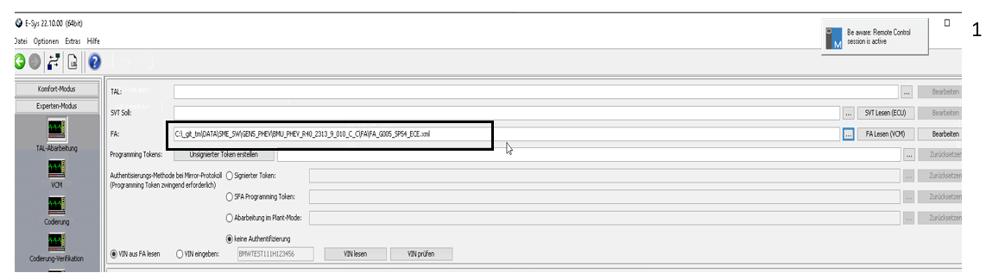
III/ FA charging:
Import FA file from the software folder C:\_git_tm\DATA\SME_SW

Slide 7
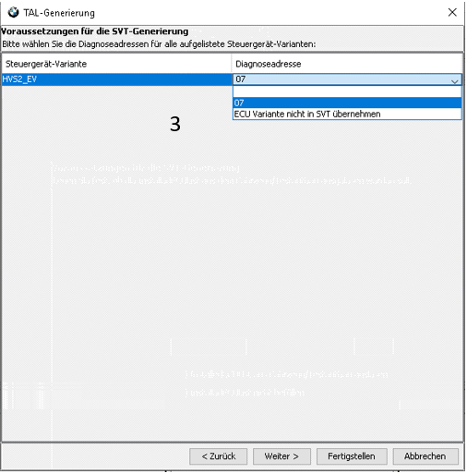
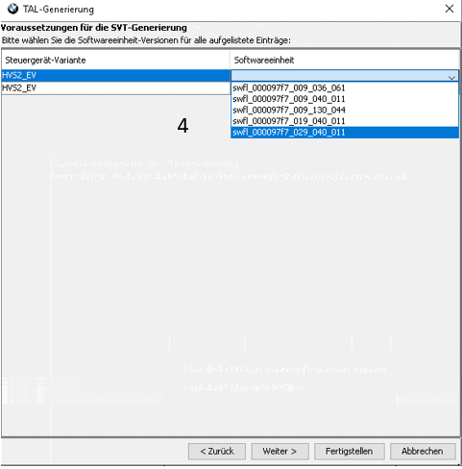

Slide 8
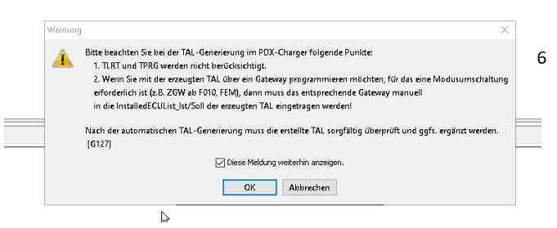
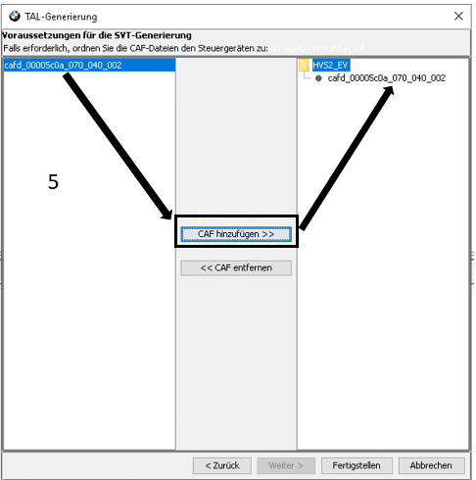
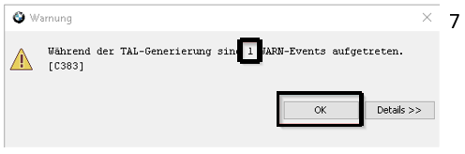

Slide 9
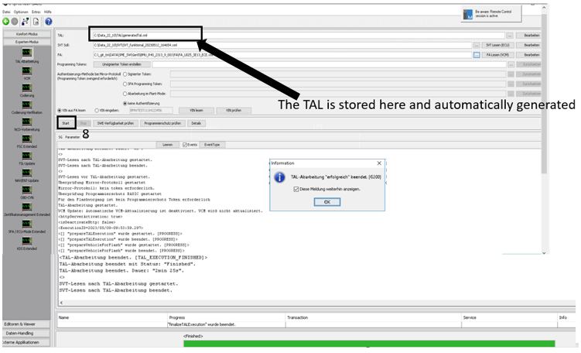

Slide 10
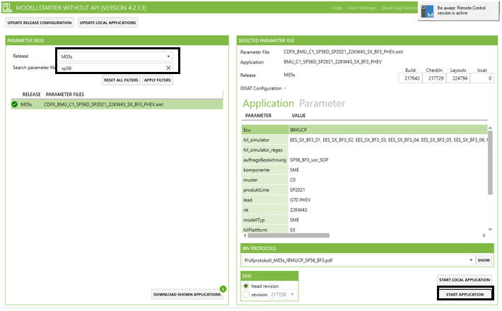
V/ ModelStarter:
Choose the the model M05 , the specific variant and apply it
1

Slide 11

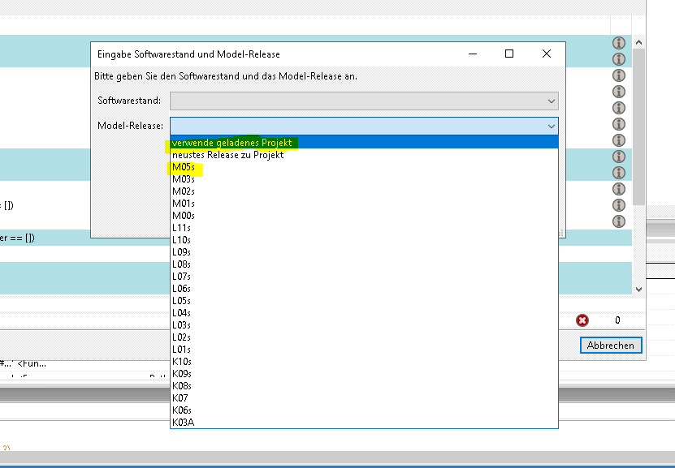
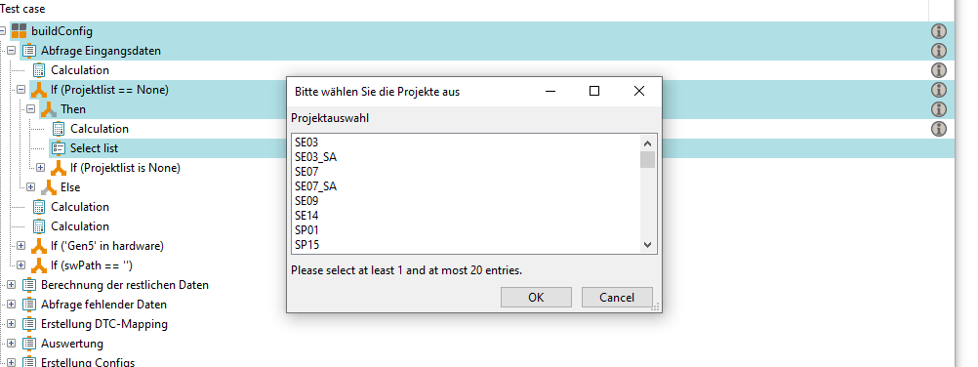
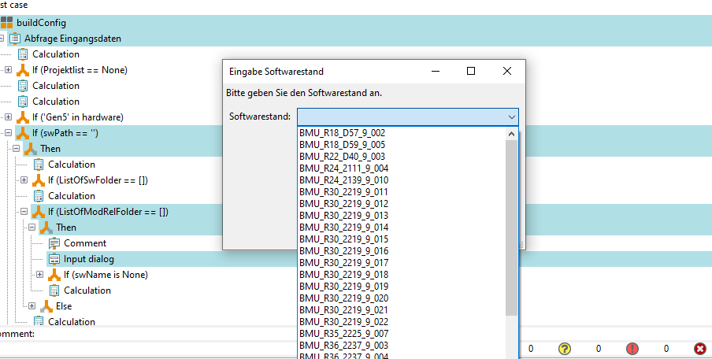

VI/ TCF upload and creation:
Import the new TCF file, if you don‘t find it you can proceed those steps below to create it (methode available only for Gen5 ):
e. Select the model M05 (pop-up apears only on the Hil) or choose the first option if you already uploaded the model
Check first the SW exist in the SME-SW folder
b. Run the buildConfig.pkg
c. Choose the specific variant (SE10, SP54…)
d. Select the SW version
f. Go to the configuration folder and you will find the TCF created

Slide 12
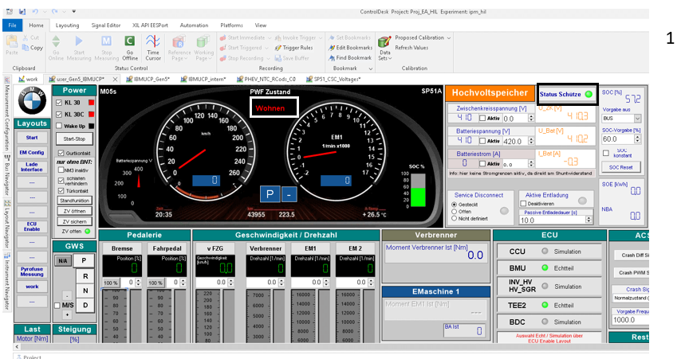
VII/ Start Application, control desk:
Get Started to Wohnen mode and close the contactors

Slide 13
Thank you !
☺

